Slide 1
PURCHASING DEPARTMENT
Supplier Tutorial

Slide 2
The School District of Palm Beach County
Purchasing Department Vendor Registration Process Tutorial
is available on the How to do Business webpage -
http://l.sdpbc.net/6j6l5

Slide 3
Vendor Registration Process
This presentation will inform vendors how to receive notifications regarding competitive solicitations offered through the School District of Palm Beach County for:
Goods
Services and
Construction related solicitations
To view solicitations, Vendors must register with Periscope S2G, a division of Periscope Holdings, our online e-procurement service

Slide 4
How it Works
The Vendor registration identifies vendors who wish to receive Competitive Solicitations released by the Purchasing and Construction Purchasing Department for the School District of Palm Beach County, Florida
Periscope S2G’s automated notification services will send new opportunities via e-mail
All responses must be submitted electronically. Hard copy or email responses will not be accepted

Slide 5
Registration Process Overview
Register your company online for free with Periscope S2G @ BidSync.com/SDPBC
Once you have agreed to the Terms and Conditions of Periscope S2G, you will have access to view all bids
Receive email or fax notifications of competitive solicitations when released

Slide 6
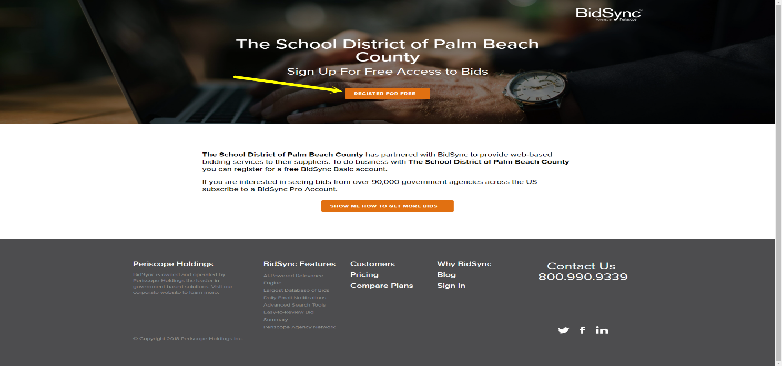
Register for Free
Go online to our e-procurement service: Periscope S2G

Slide 7
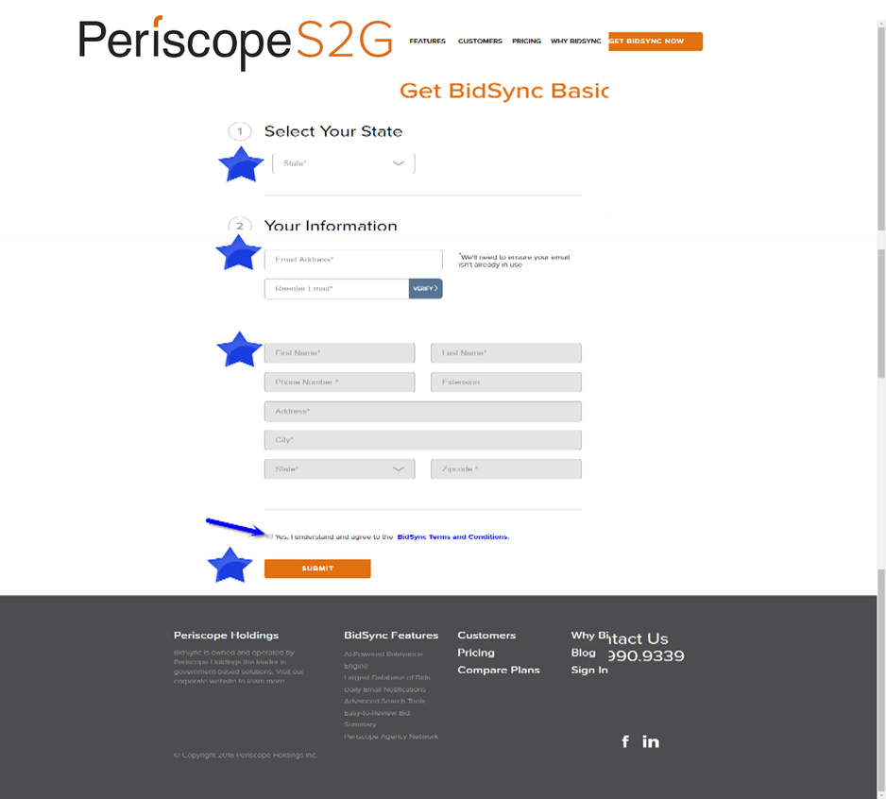
Tell us about you

Slide 8
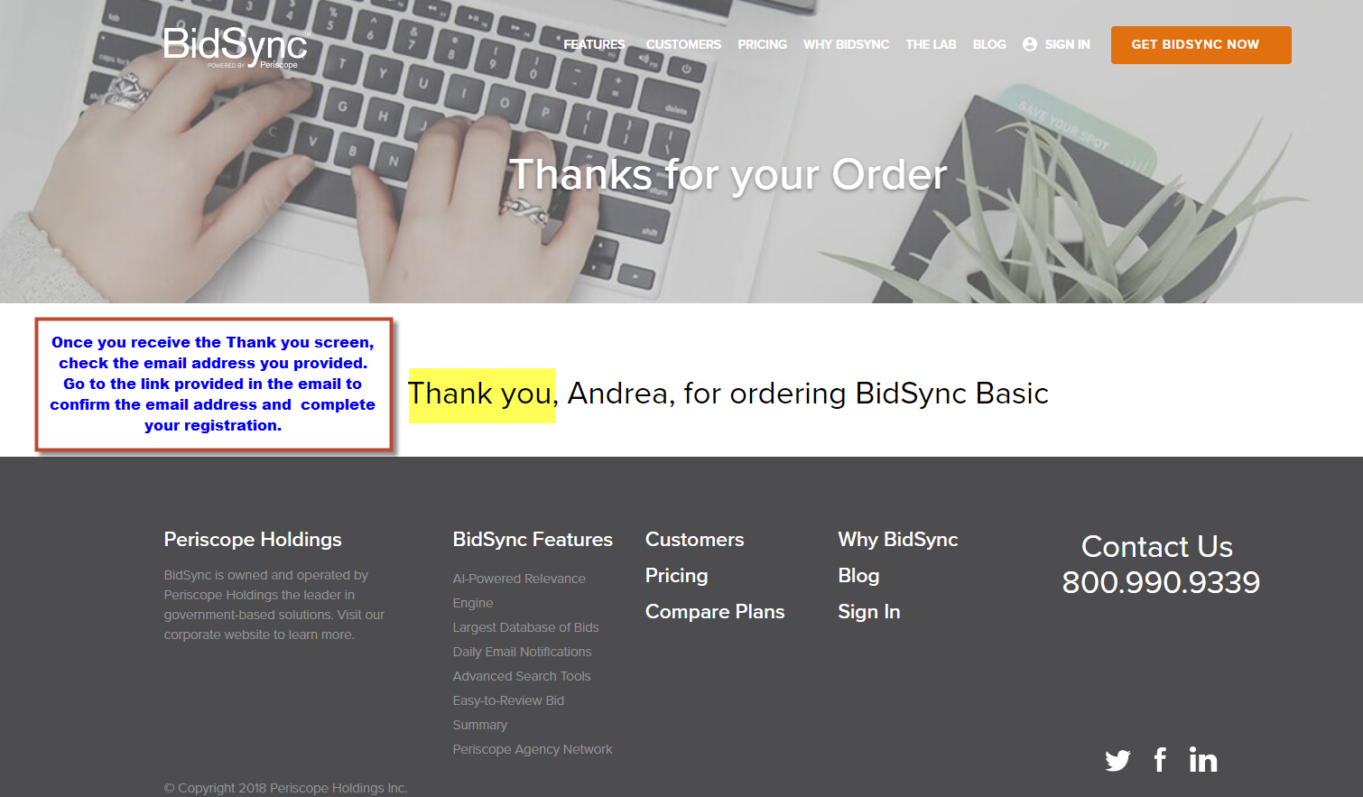
Thank You Screen

Slide 9
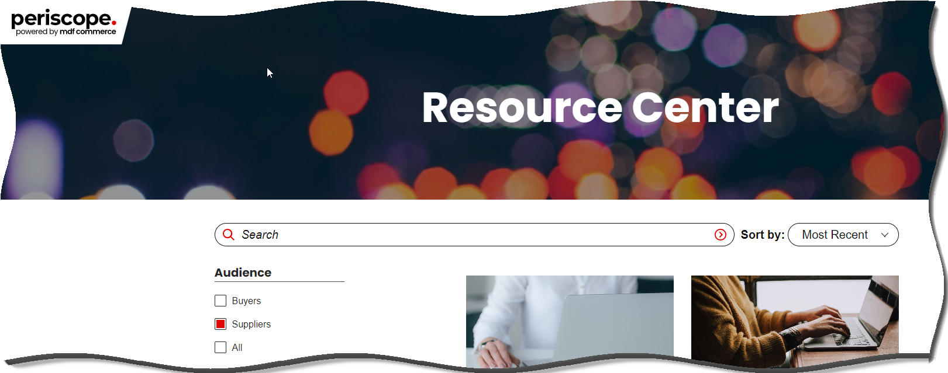
The School District of Palm Beach County
For helpful information please visit
https://www.periscopeholdings.com/resource-center

